Slide 1
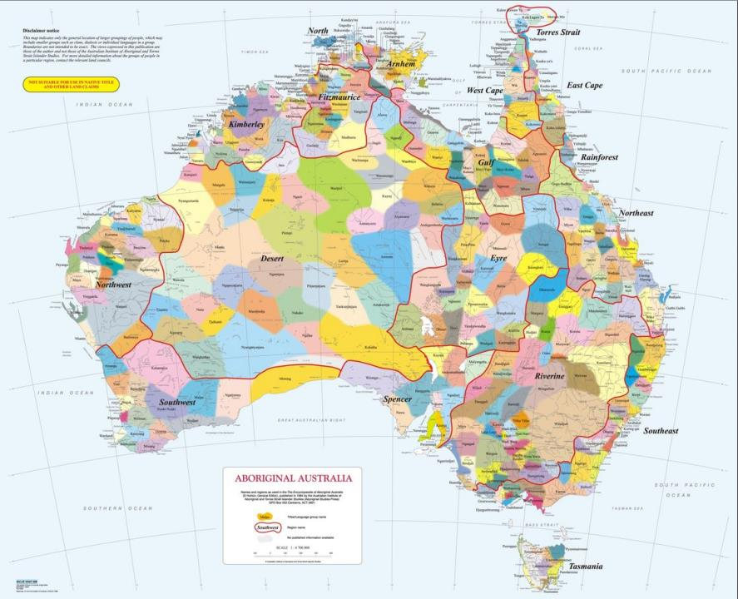
Aboriginal history of SA since 1800
Aboriginal history in SA since 1800
Notes:
http://taungurung.com.au/wp/wp-content/uploads/2016/06/country-aiatsis-map.jpg

Slide 2
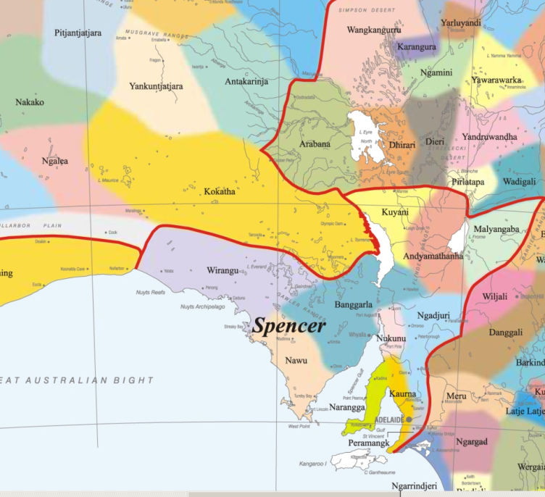
Notes:
http://taungurung.com.au/wp/wp-content/uploads/2016/06/country-aiatsis-map.jpg

Slide 3
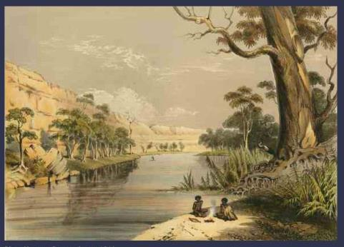
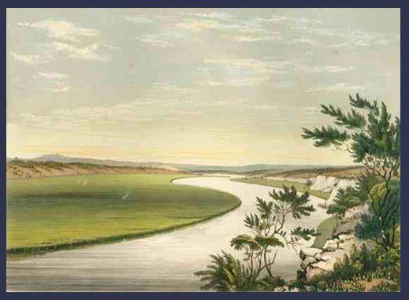
River Murray, painted by George French Angas 1846
Above: Up river where fresh water allows gum trees to grow healthily.
Left: Near Tailem Bend, where river water was brackish (salty).

Slide 4
Departure of Sturt in search of inland sea

Slide 5
Adelaide 1846, George French Angas

Slide 6
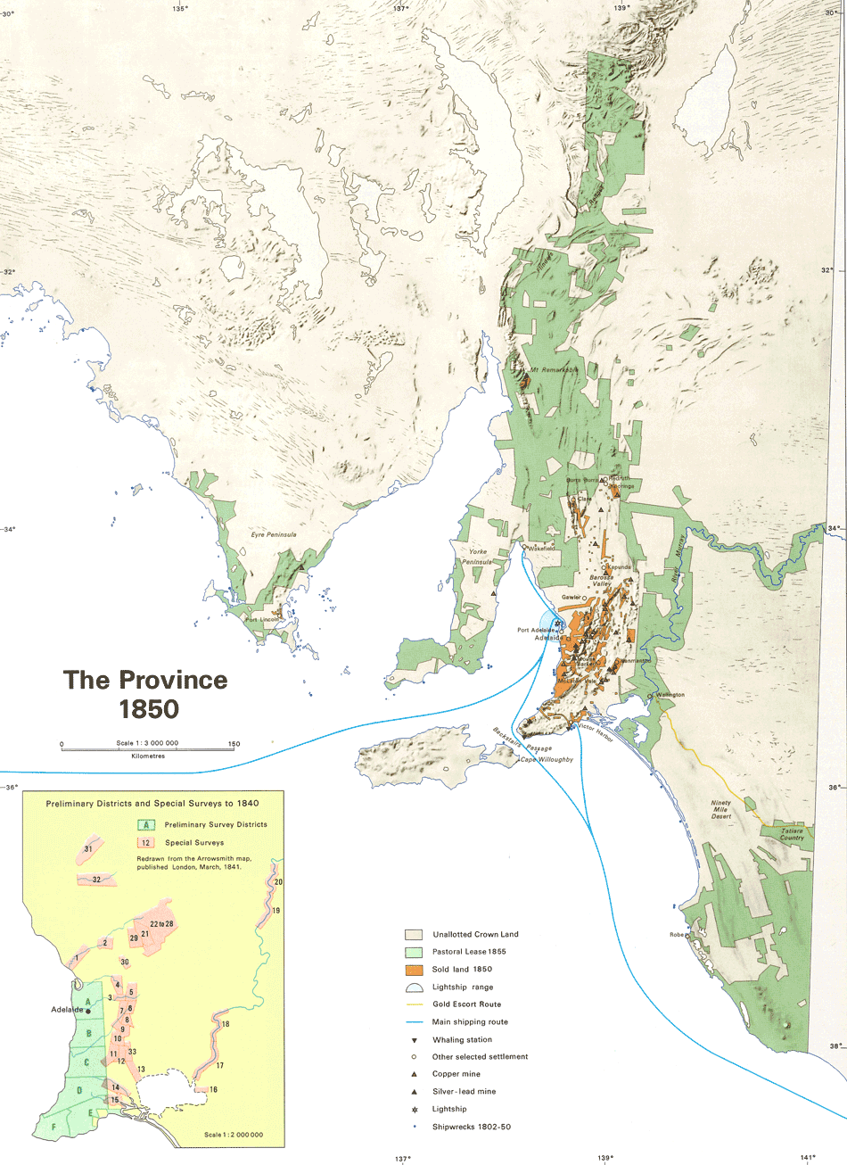
The Province 1850
from The Atlas of South Australia

Slide 7
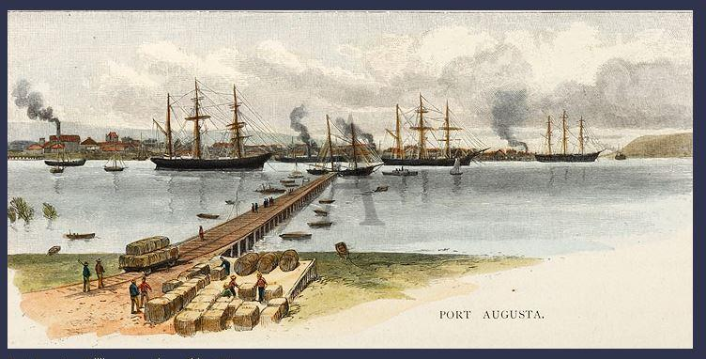
Port Augusta
by William Crowthers Fitler 1886

Slide 8
To Poonindie by ship from Adelaide

Slide 9
Point Pearce Mission
The red dot shows the location of the Point Pearce Mission on what was once all Narungga land (green)
.

Slide 10
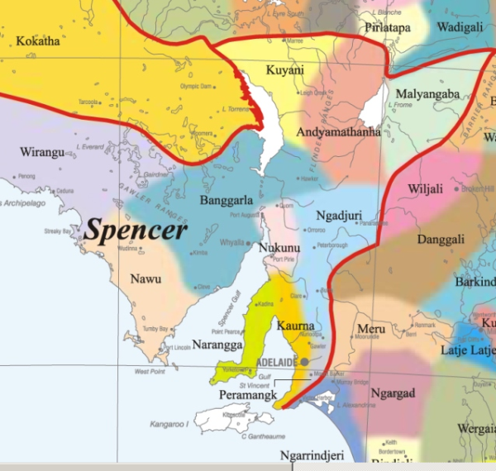
Train line Pt Augusta to Marree

Slide 11
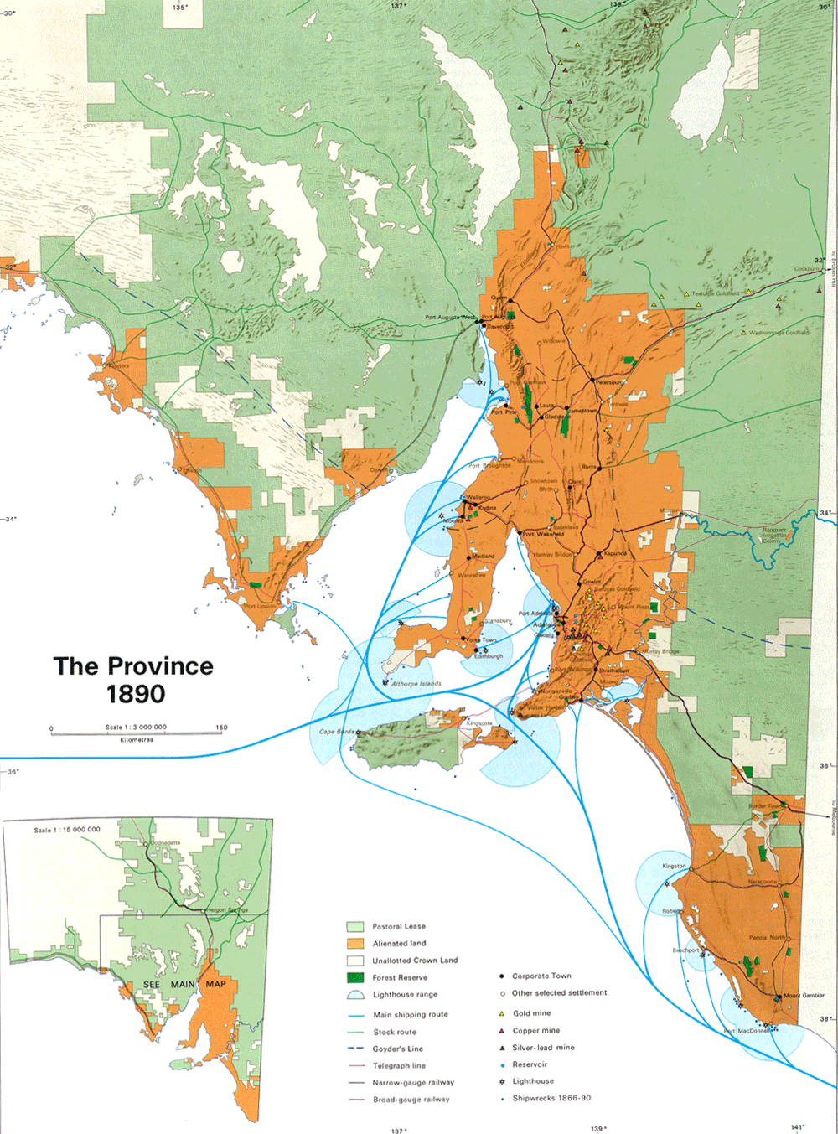
South Australia 1890
Green is Pastoral Leasehold
Orange is Freehold land

Slide 12
Trainline through Ooldea to WA
Ooldea

Slide 13
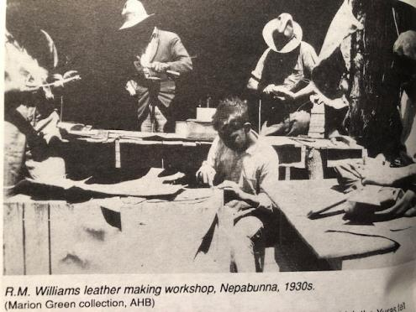
Nepabunna Mission
https://collections.slsa.sa.gov.au/resource/PRG+1218/34/834C/continue

Slide 14
Nepabunna
Port Augusta

Slide 15
Ernabella
Ooldea

Slide 16
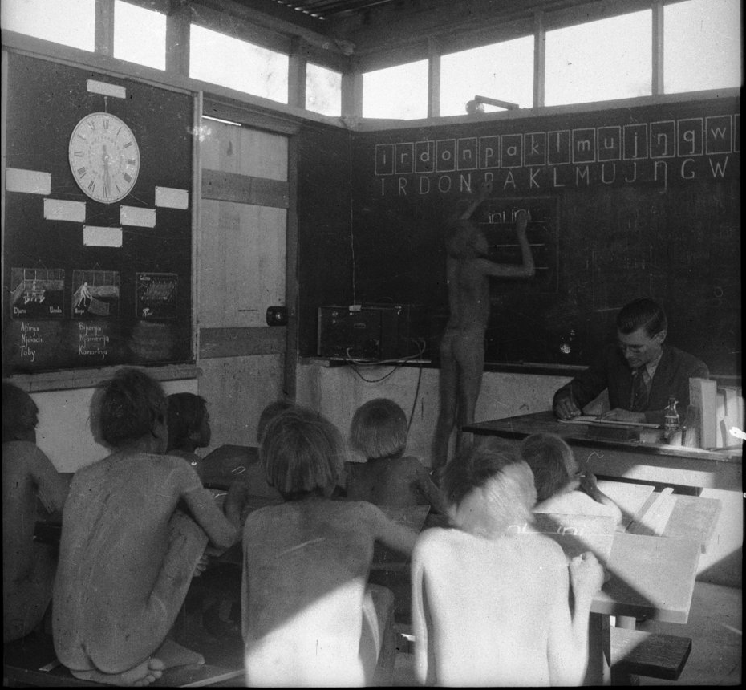
Ernabella School
https://digital.collections.slsa.sa.gov.au/nodes/view/2750
https://digital.collections.slsa.sa.gov.au/nodes/view/2749

Slide 17
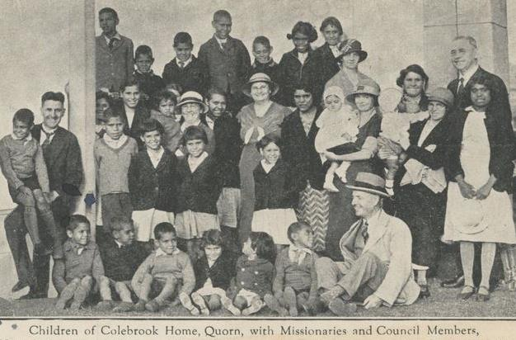
Colebrook Homes

Slide 18
Grieving mother statue at Colebrook Reconciliation Park, Eden Hills

Slide 19
Australian curriculum
Drama
By the end of Year 4, students describe and discuss similarities and differences between drama they make, perform and view. They discuss how they and others organise the elements of drama in their drama.
Students use relationships, tension, time and place and narrative structure when improvising and performing devised and scripted drama. They collaborate to plan, make and perform drama that communicates ideas.
HASS
Pose questions to investigate people, events, places and issues
Locate and collect information and data from different sources, including observations
Sequence information about people’s lives and events
Examine information to identify different points of view and distinguish facts from opinions
Draw simple conclusions based on analysis of information and data

Slide 20
Aboriginal and Torres Strait Islander Histories and Cultures Cross-Curriculum Priority in HASS
The diverse cultures of Aboriginal … Peoples are explored through their:
long and continuous strong connections with Country/Place and their economic, cultural, spiritual and aesthetic value of place ....
experiences before, during and after European colonisation including the nature of contact with other peoples, and their progress towards recognition and equality …
Students explore how
… groups express their particular identities, and come to understand how group belonging influences perceptions of others.
use of primary and secondary sources, including oral histories, gives students opportunities to see events through multiple perspectives, and to empathise and ethically consider the investigation, preservation and conservation of sites of significance to Aboriginal …Peoples.

Slide 21
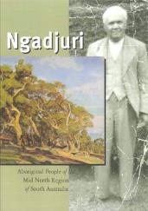
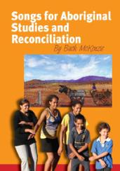
www.hass-sa.asn.au/resources
Aboriginal history role play scripts (multiple)
Teaching about Aboriginal art and the Dreaming slide show and notes
Ngadjuri: Aboriginal people of the Mid North Region of South Australia (book)
Songs for Aboriginal Studies and Reconciliation songbook and CD by Buck McKenzie
Backing tracks for Buck’s songs so children can easily sing along
and other Aboriginal studies downloads

